Slide 1
Enterprise Messaging
Group Management
Last Updated 05/29/2025

Slide 2
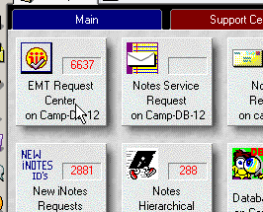
Admin instructions on Group Management
The Database we use to Manage Group Administration Requests is the EMT Request Center on camp-db-12

Slide 3
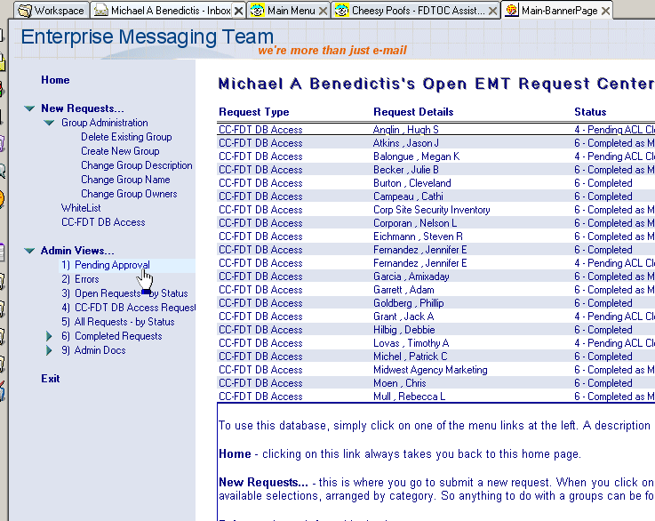
Admin instructions on Group Management (Cont.)
Look in Admin Views -> Pending Approval to see open requests

Slide 4
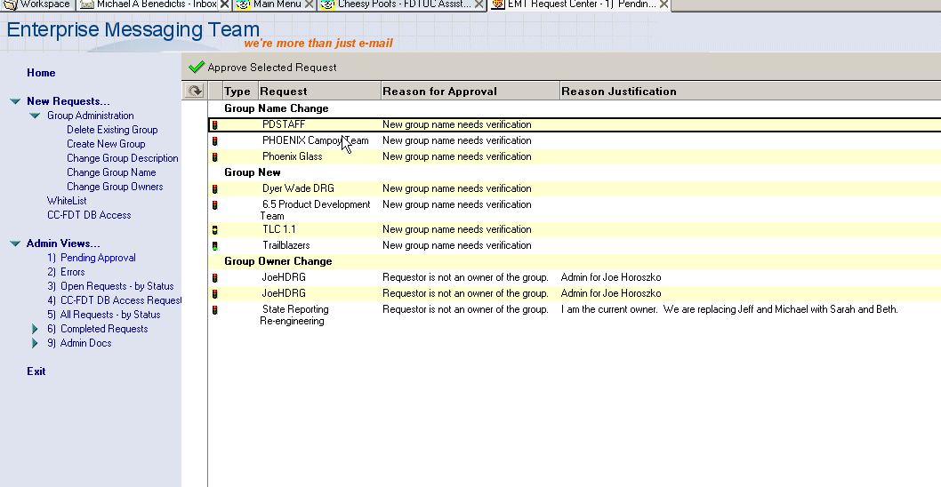
Admin instructions on Group Management (Cont.)
The Open Requests Home Page

Slide 5
Admin instructions on Group Management (Cont.)
Types of request
  Group New
  Group Name Change
  Group Owner Change
  Group Description Change
  Group Delete
  Mail-In DB Request New DB
  Mail-In DB Doc Only – TO BE COMPLETED BY Collab
  User Investigation – TO BE COMPLETED BY Collab
  User Name Change – TO BE COMPLETED BY Collab

Slide 6
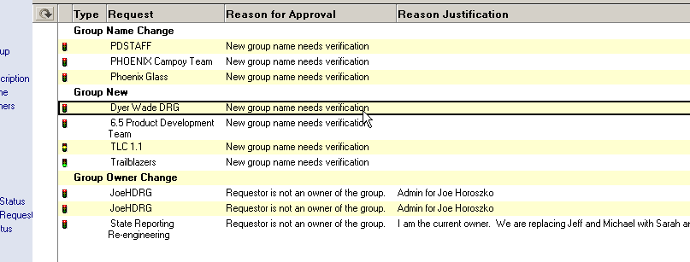
Approving a New Group Name
Select the Group Name

Slide 7
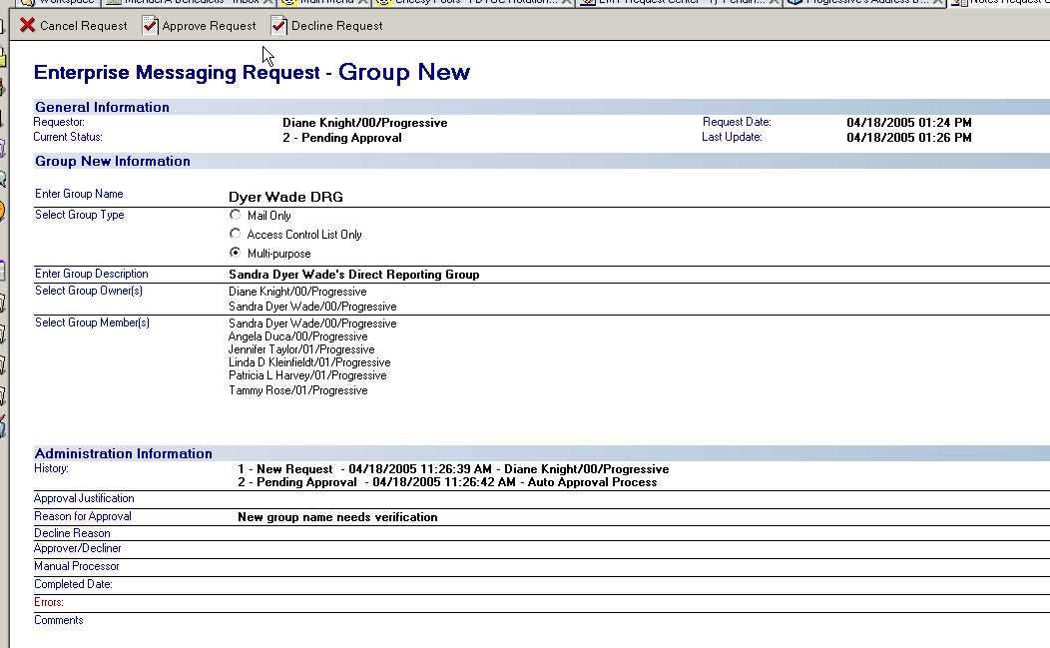
Approving a New Group Name (Cont.)
Verify the Requester has filled in all of the necessary information

Slide 8
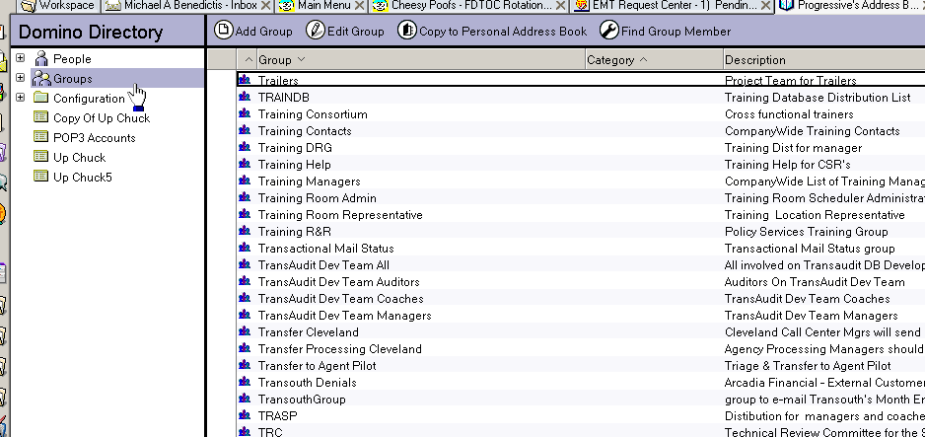
Approving a New Group Name (Cont.)
Check the Progressive Address Book – Under “Groups” to verify that the group name is not currently in use

Slide 9
Approving a New Group Name (Cont.)
Verify that the New Group Name meets Progressive Standards
Verify that the New Group DOES NOT have a comma and or semicolon
We typically try to stay away from using periods as well to separate names, it is best to just space it out and allow it to use spaces internal or underscores external.
Acceptable period use would be Remedy 7.4 Team

Slide 10
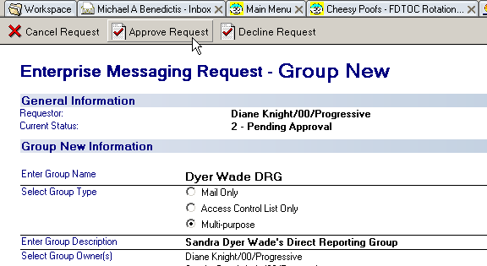
Approving a New Group Name (Cont.)
For Example, Group names which may conflict with guidelines established in the Progressive Way, or may be deemed offensive, should not be approved.
Once this has been completed, Approve the Request by clicking the button in the Toolbar

Slide 11
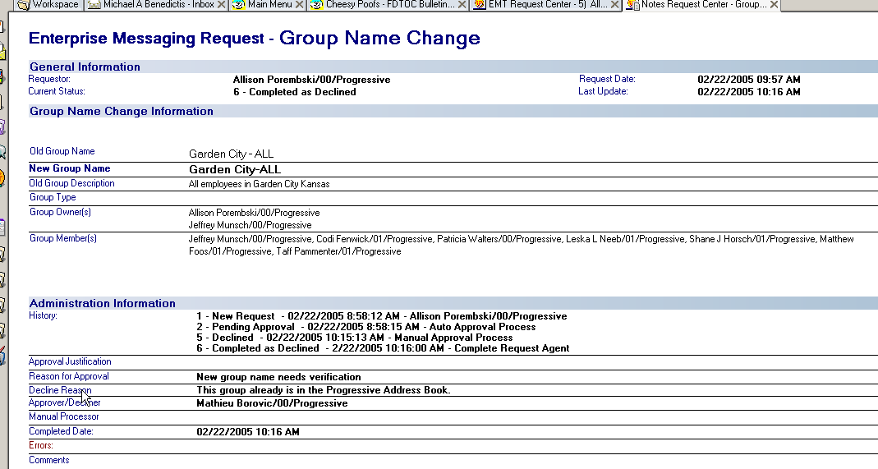
Approving a New Group Name (Cont.)
Example of a Declined Request – include the Decline Reason

Slide 12
Approving a New Group Name (Cont.)
As a General Rule, you will look to approve the request. The overwhelming majority of requests are approved.
Reasons to decline a New Group Request are generally that the Group Name already exists, or it is inappropriate for Progressive Standards.
Use your best judgment in determining Approval/Decline on Requests.
If you are skeptical on approving the request on a New Group Name, you may send the Requester a Note asking for Business Justification of the Group Name.
Ask others in the Group their opinion on the Group name to gather other individuals perspective’s on the name

Slide 13
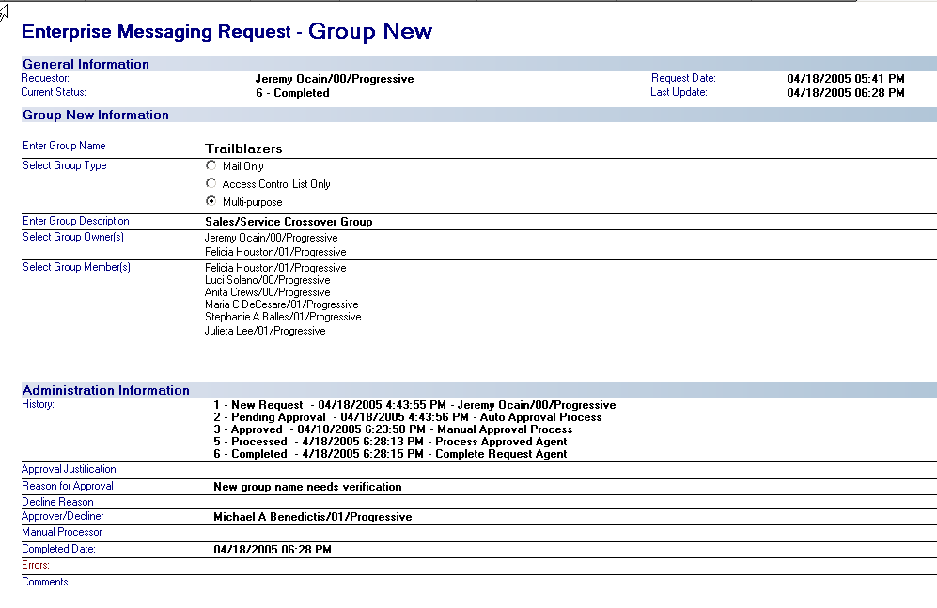
Approving a New Group Name (Cont.)
Example of an Approved Completed Request for New Group Name

Slide 14
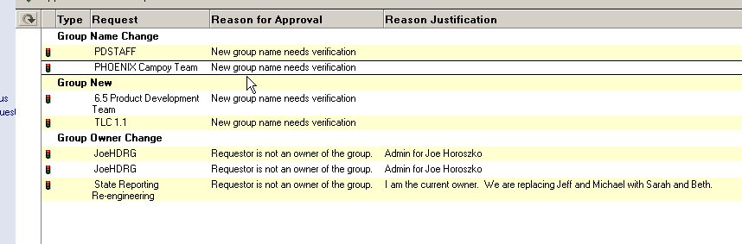
Approving a Group Name Change
Works Similar to Approving a New Group

Slide 15
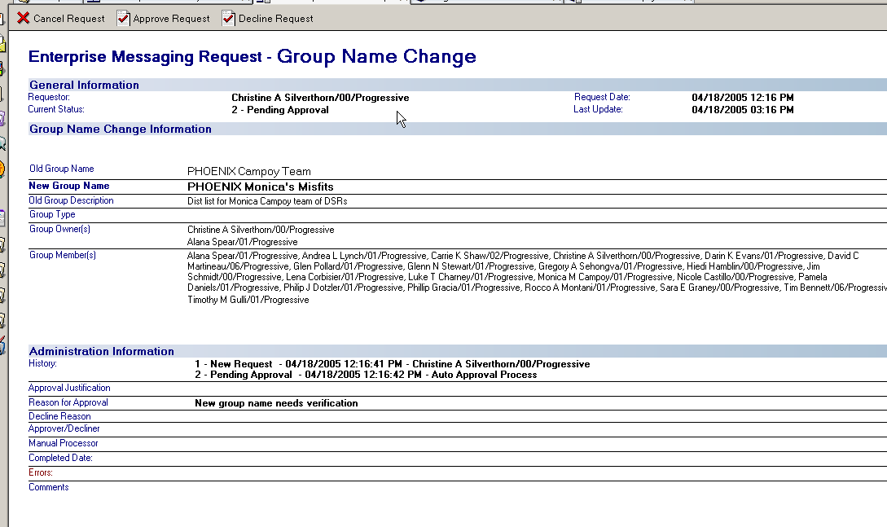
Approving a Group Name Change (Cont.)
Check the Requestor to see if they are a Group Owner

Slide 16
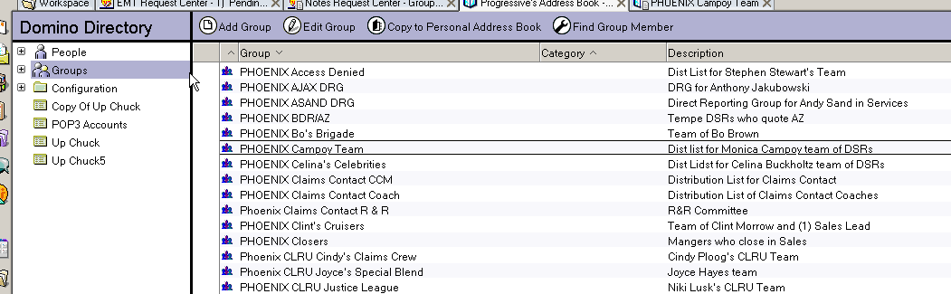
Approving a Group Name Change (Cont.)
Check the Progressive Address book to verify that the New Group Name is not already in use

Slide 17
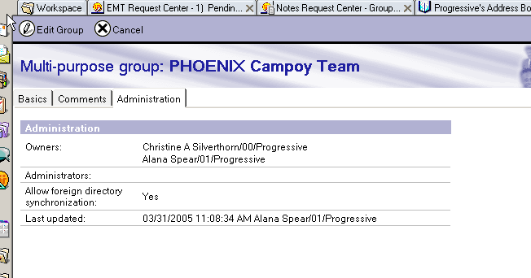
Approving a Group Name Change (Cont.)
You can also see the Owners of the Current Group Name listed in the Address book

Slide 18
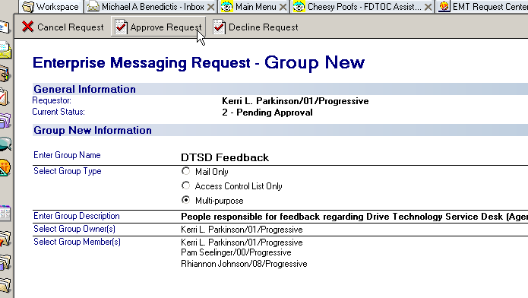
Approving a Group Name Change (Cont.)
Approving or Declining the Request works the Same way as a New Group Request

Slide 19
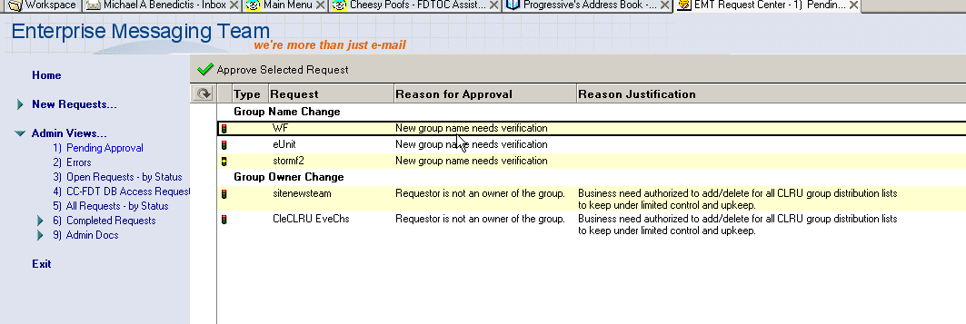
Approving a Group Name Change (Cont.)
Group Name Changes may also come in for Mail-in Databases

Slide 20
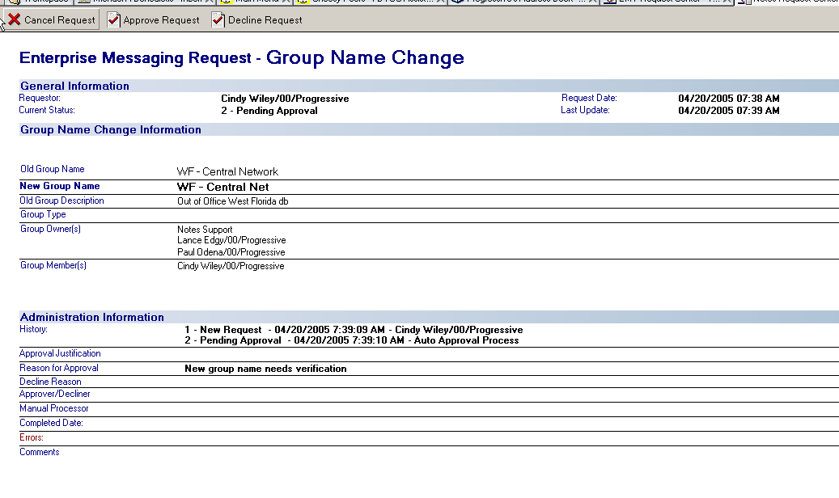
Approving a Group Name Change (Cont.)
Example of Name Change for Mail-in Database

Slide 21
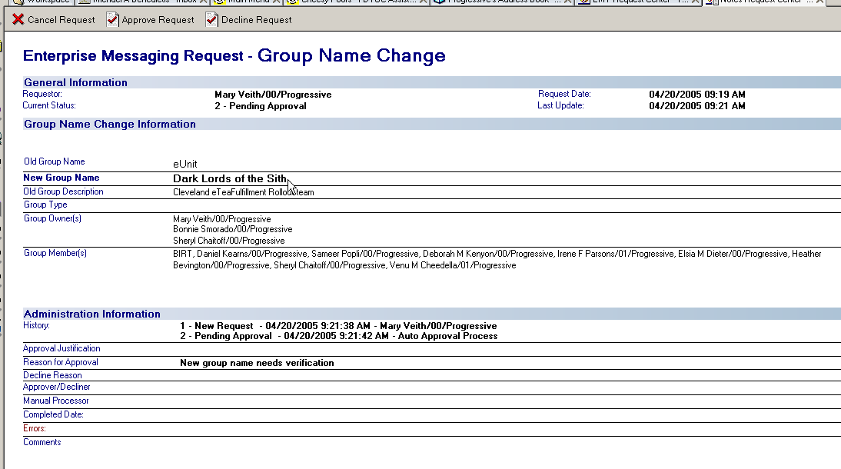
Approving a Group Name Change (Cont.)
Example of a Group Name Change that the Name may be inappropriate

Slide 22
Approving a Group Name Change (Cont.) - Placeholder Requests
Do not approve Placeholder Requests, advise user to Delete Distro and then create a New One.

Slide 23
Approving a Group Name Change (Cont.)
Example of a Group Name Change that the Name may be inappropriate
Inappropriate language, derogatory, hate speech, not fitting to Progressive Core Principles of Diversity, Equity, and Inclusion and Core Values

Slide 24
Approving a Group Name Change (Cont.)
As a General Rule, you will look to approve the request. The overwhelming majority of requests are approved.
Reasons to decline a Group Name Change Request are generally that the Group Name already exists, or it is inappropriate for Progressive Standards.
Use your best judgment in determining Approval/Decline on Requests.
If you are skeptical on approving the request on a Group Name Change, you may send the Requester a Note asking for Business Justification of the Group Name.
Ask others in the Group their opinion on the Group name to gather other individuals perspective’s on the name

Slide 25
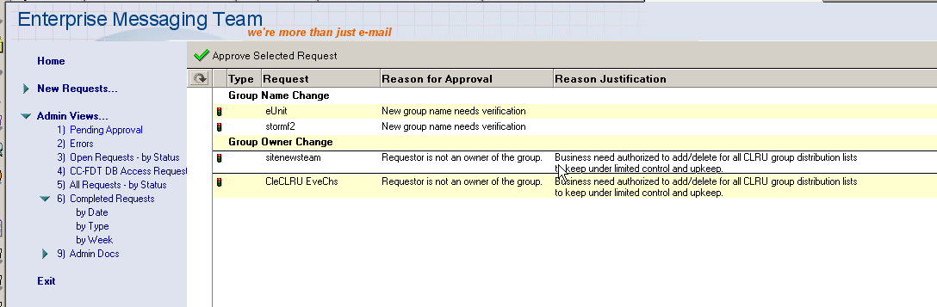
Approving a Group Owner Changes
Requests should generally come from the Current Owner of the Distribution List

Slide 26
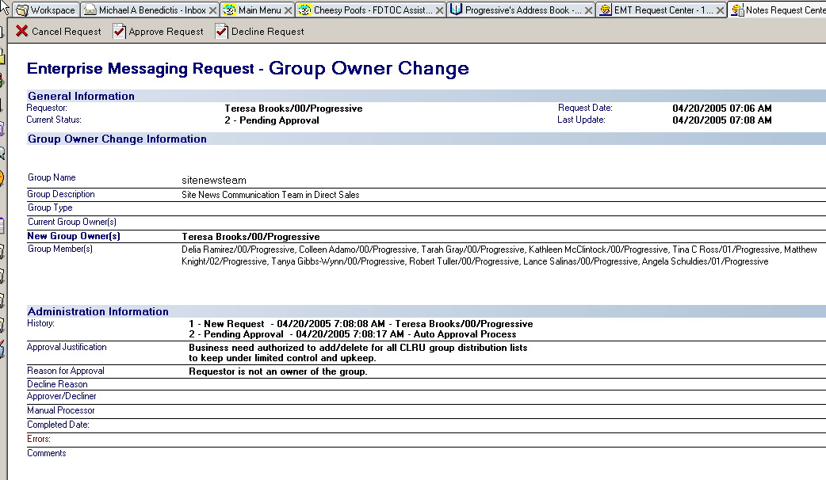
Approving a Group Owner Changes (Cont.)
Example of Group Owner Change – No current Owner of Group

Slide 27
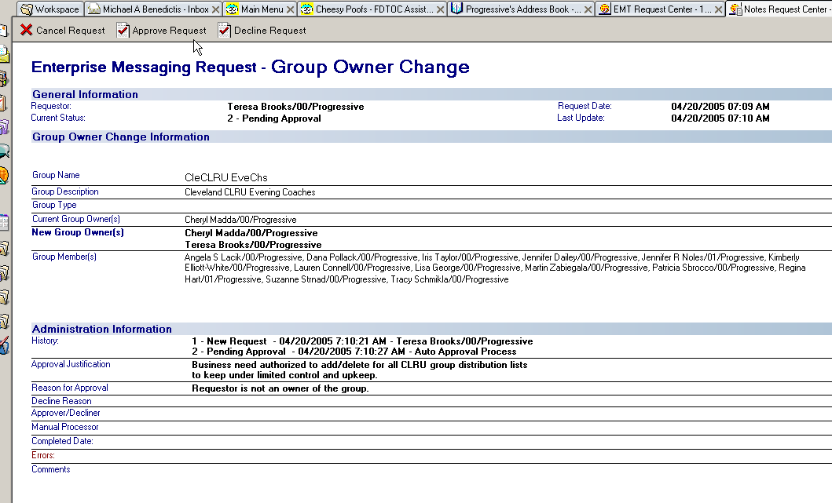
Approving a Group Owner Changes (Cont.)
Requester wants to be added as an owner

Slide 28
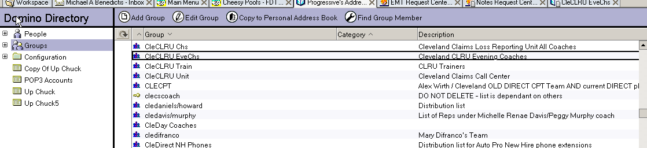
Approving a Group Owner Changes (Cont.)
You can also verify the Group information in the Address book

Slide 29
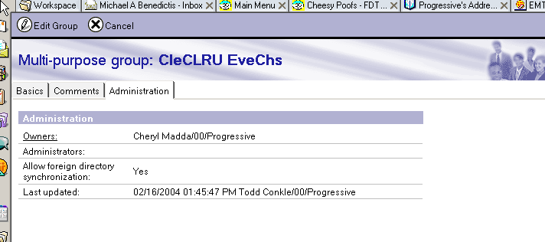
Approving a Group Owner Changes (Cont.)
Current Group Owners and Last Update

Slide 30
Approving a Group Owner Changes (Cont.)

Slide 31
Approving a Group Owner Changes (Cont.)
In General, Requests for Group Owner Change should come from the Group Owner and get approved automatically.
But, requests may come from
  An Administrative Assistant (AA)
  Name of the owner is formatted to non hieratical format
  The requester may place additional comments into the request.
    For example, they may say that the Current Owner has not been with that group for years, and they are administering that group.
Use your best judgment on approving these requests.
As a General Guideline, you should look to approve the request, but feel free to ask for additional information from the Requester.

Slide 32
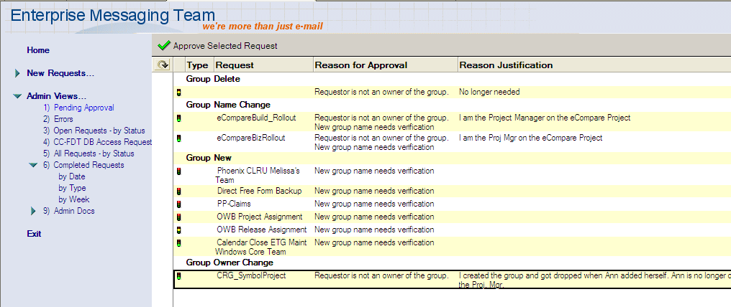
Approving a Group Description Change
Works Similar to Approving a New Group

Slide 33
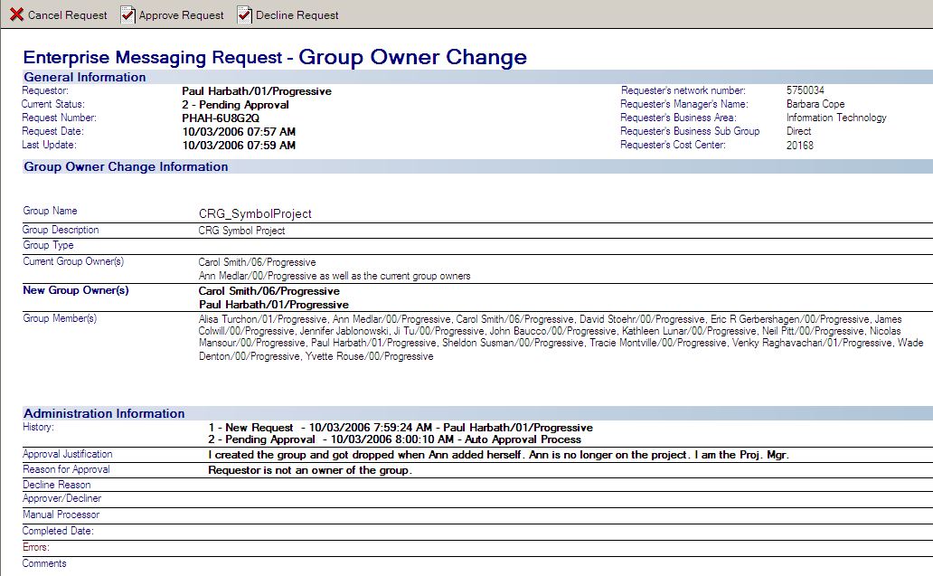
Approving a Group Description Change (Cont.)

Slide 34
Approving a Group Description Change (Cont.)
As a General Rule, you will look to approve the request. The overwhelming majority of requests are approved.
Reasons to decline a Group Description Change Request is if it is inappropriate for Progressive Standards.
Use your best judgment in determining Approval/Decline on Requests.
If you are skeptical on approving the request on a Group Description Change, you may send the Requester a Note asking for Business Justification of the Group Description.
Ask others in the Group their opinion on the Group Description to gather other individuals perspective’s on the name

Slide 35
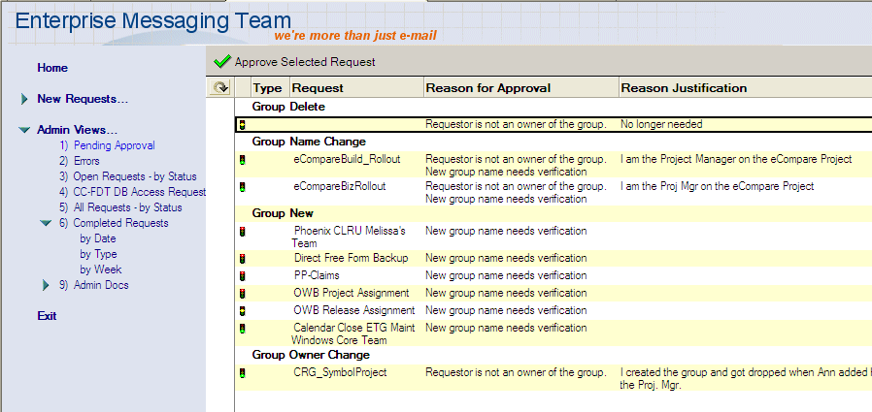
Approving a Delete Group
Works Similar to Approving a Group Owner Change

Slide 36
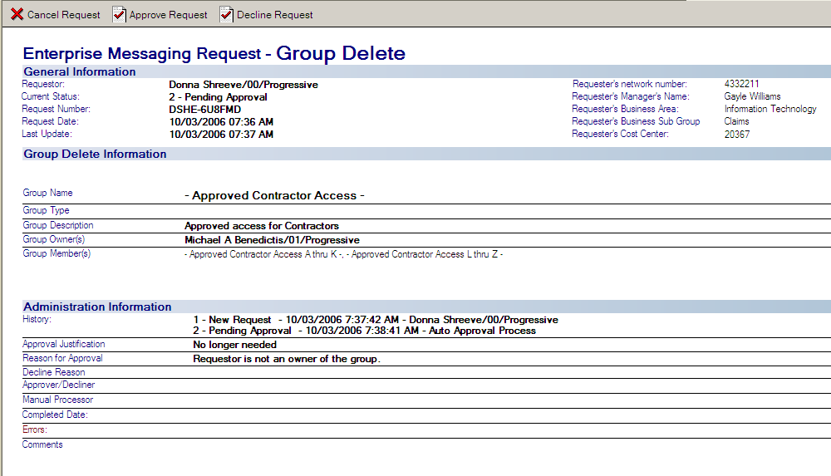
Approving a Delete Group (Cont.)
DO NOT approve the group delete for – Approved Contactor Access –
This is commonly selected since it’s the first option in the list when customer is putting in the request

Slide 37
Approving a Delete Group (Cont.)
Groups NEVER to Delete
  - Approved Contractor Access -
  - Default Contractor Access -
  LocalDomain Servers
  OtherDomainServers
  LocalDomainAdmins
  CorpSys-NotesDev
  servers (i.e. Camp-db-01)
  LocalDomainCatalogServers
  LocalDomainRelays

Slide 38
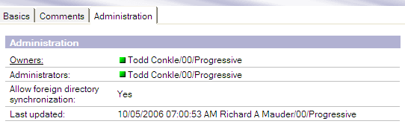
Approving a Delete Group (Cont.)
Never delete any groups owned by
  EMA member
    Members are listed in ETG-BY group
  EMA Notify

Slide 39
Approving a Delete Group (Cont.)
In General, Requests for Deleting a Group should come from the Group Owner and get approved automatically.
But, requests may come from
  An Administrative Assistant (AA)
  Name of the owner is formatted to non hieratical format
  The requester may place additional comments into the request.
Make sure that the business justification for deleting the group is solid if your not sure ask a senior member of the escalation team.

Slide 40
What happens when you approve the request for Group Delete
The request deletes the group from the Progressive Address Book.
Creates an Administration Request that automatically runs.
  Delete the group from the ACL of any database it may be in.
  Delete the group from any other groups that its nested in.

Slide 41
Approving a Mail-In DB Request New DB
Follow the same guidelines and steps as for a New Group Name request above with one additional check.
The one additional place to check for a conflict is in the Progressive Address Book under Configuration > Messaging > Mail-In Databases
If there is a conflict or it already exists

Slide 42
Approving a Mail-In DB Request New DB (Cont.)
As a General Rule, you will look to approve the request. The overwhelming majority of requests are approved.
Reasons to decline a Mail-In DB Request are generally that the Group Name already exists, or it is inappropriate for Progressive Standards.
Use your best judgment in determining Approval/Decline on Requests.
If you are skeptical on approving the request on a Mail-In DB Name, you may send the Requester a Note asking for Business Justification of the Mail-In DB Name.
Ask others in the Group their opinion on the Mail-In DB name to gather other individuals perspective’s on the name

